Slide 1



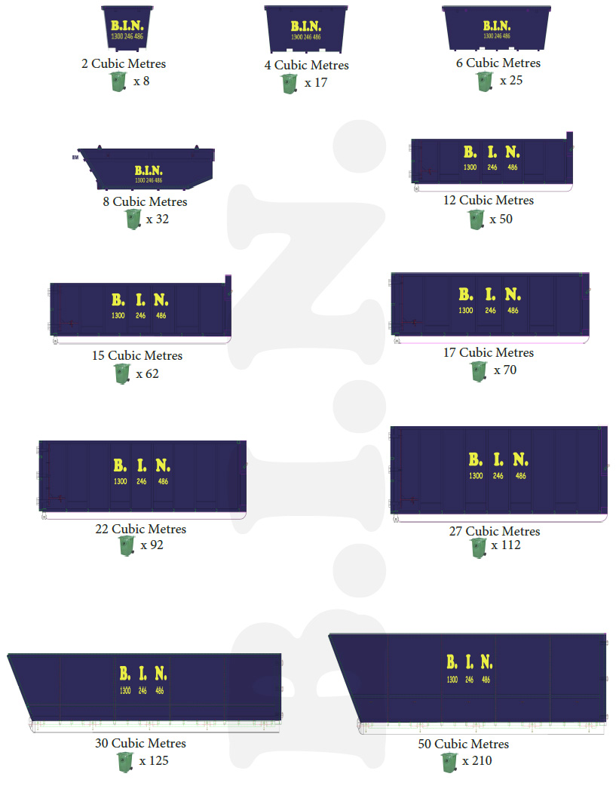



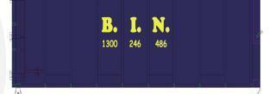
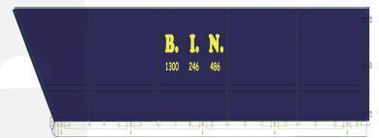
BIN DIMENSIONS SHOWN IN MILLMETRES
1350x1350x1250
2500x1500x1250
3600x1500x1250
4500x1700x1250
4790X1975X1215
5325X1975X1415
5325X1975X1625
6150X1975X1815
6150X1975X2220
10310X2080X1644
10310X2080X2133

